Slide 1
Westminster Park Association
October 18, 2011

Slide 2
Westminster Park Association
Agenda:
Greetings & opening remarks - Clay
Treasurer’s Report – Budget & Dues - Mike
Community Improvement(s) - Mike
Snow Removal for 2011/2012 - Clay
Community Website - Mike
Other Items & Q & A - Darryl

Slide 3
Westminster Park Association
Treasurer’s Report
Current bank account balance $6,525.91
Reconciled through 10/17/2011
2011 Expenditures since 5/21/11 $860.85
Dues – 2011
Dues collected $3,687
Commitments $0
Delinquent (11 properties) + $110 Late Fees $2,223
Dues - 2010 – Collected $3,700
Delinquent (11properties) $2,100
8 properties owe for 2010 and 2011. Face small claims court and additional property liens.

Slide 4
Westminster Park Association
Snow Removal Plan - 2011 / 12
Removal Firm – Stellar Custom Carpentry
Chris Poupore
Streets plowed at 3” - $100 per push or
Re-push on same day at $50 per push or….
Seasonal plan (10 pushes) $900
Additional pushes after 10 - $100
Driveways & Walks @ Homeowner Expense
Driveways $20.00 - plus walks $30.00

Slide 5
Westminster Park Association
Community Website: Westminsterpark.org
View Bi-Laws, Annual Meeting Minutes, Monthly Board Meeting Minutes, Monthly Finances.
Place to post news and events.
Make online payments.

Slide 6
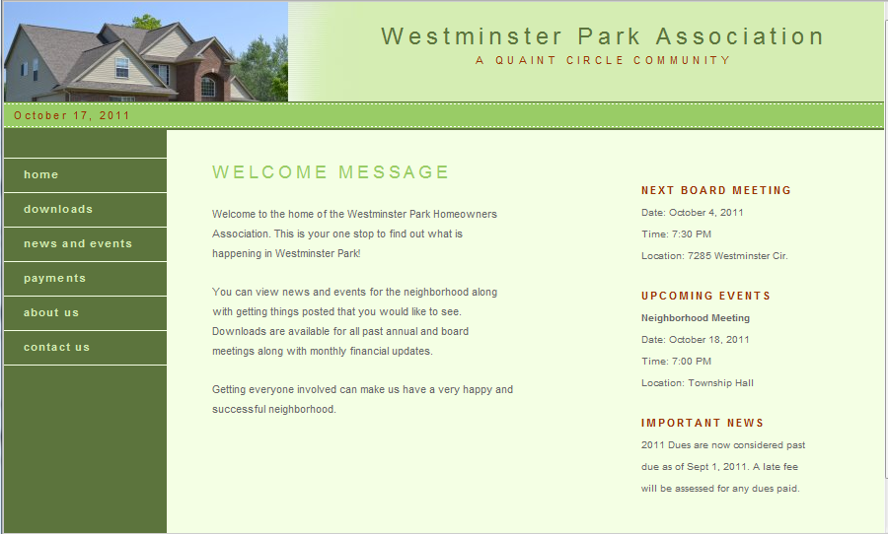

Slide 7
Westminster Park Association
Other Items:
Neighborhood improvements
Street Lighting proposal
Signage
Questions & Answers

